Slide 1

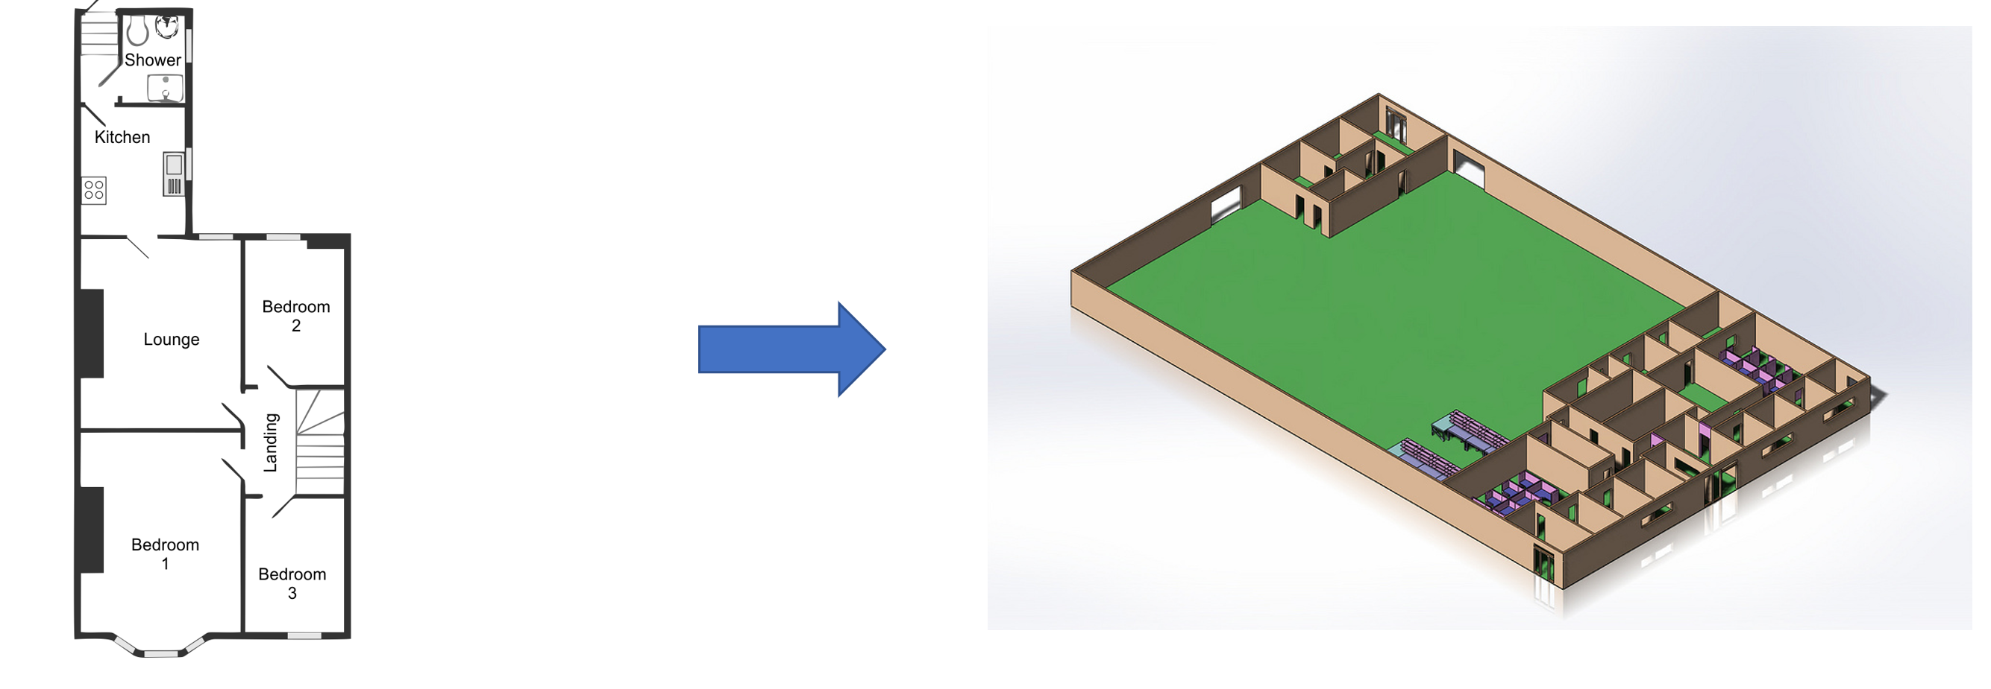
Floorplan To Blender

Slide 2
What CAN IT DO?

Slide 3
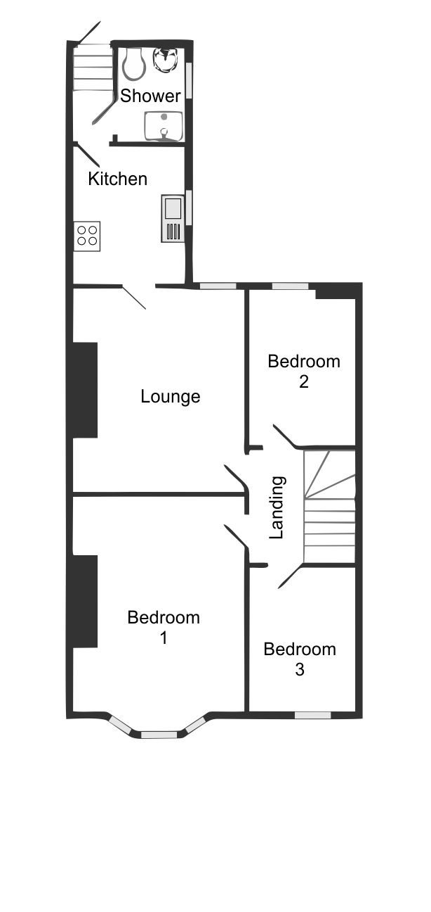
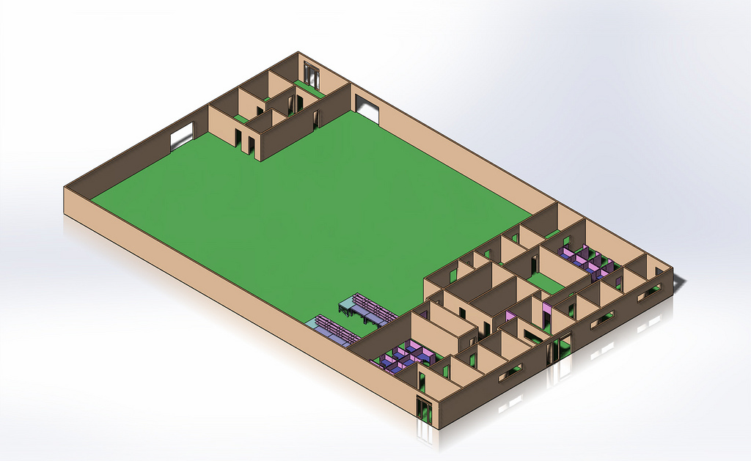
Convert a 2d floorplan image to 3d
2D
3D

Slide 4
How DOES IT WORK?

Slide 5
Lets Take a closer look…
2D
3D

Slide 6
We need an image to convert
Input Image

Slide 7
Input image
Input images should be of floorplans of course!
Preferably png or jpeg!

Slide 8

Next Imaging is performed
Input Image
Imaging

Slide 9
Imaging
The program perform several operations to locate walls, doors, windows and rooms of your floorplan.
Library OpenCV.

Slide 10

Shapes are saved in Temp Files
Input Image
Imaging
Shape Storage

Slide 11
Shape Storage
Store calculated data describing
object locations in several .txt files.

Slide 12

A Blender project is Created
Input Image
Imaging
Shape Storage
Creation in Blender3d

Slide 13
Creating in Blender3d
Creates a blender3d project.
Creates all objects from shape storage.
Adds appropriate material just for show.
Done!
Created Blender3d project can now be exported into
a vast amount of other programs.
Such as Unity, Unreal Engine and CAD.

Slide 14
Done! BlEnder Project Ready!
Input Image
Imaging
Shape Storage
Creation in Blender3d

Slide 15
Who Made this?

Slide 16
This repostory WAS created by
Thanks for watching!
Grebtsew
All opensource content at
https://github.com/grebtsew/

